Slide 1
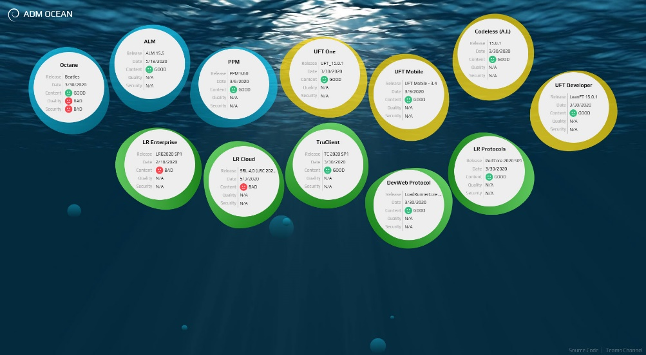
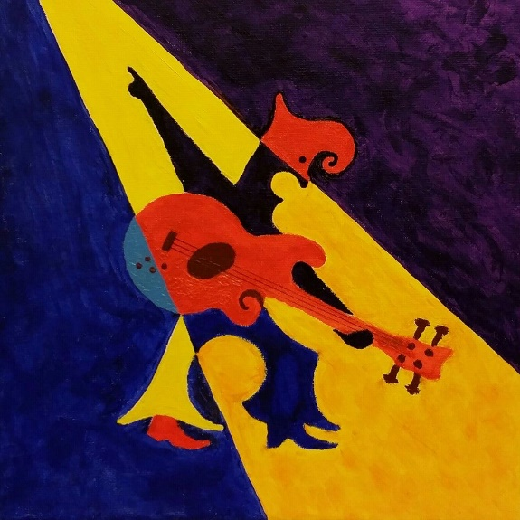



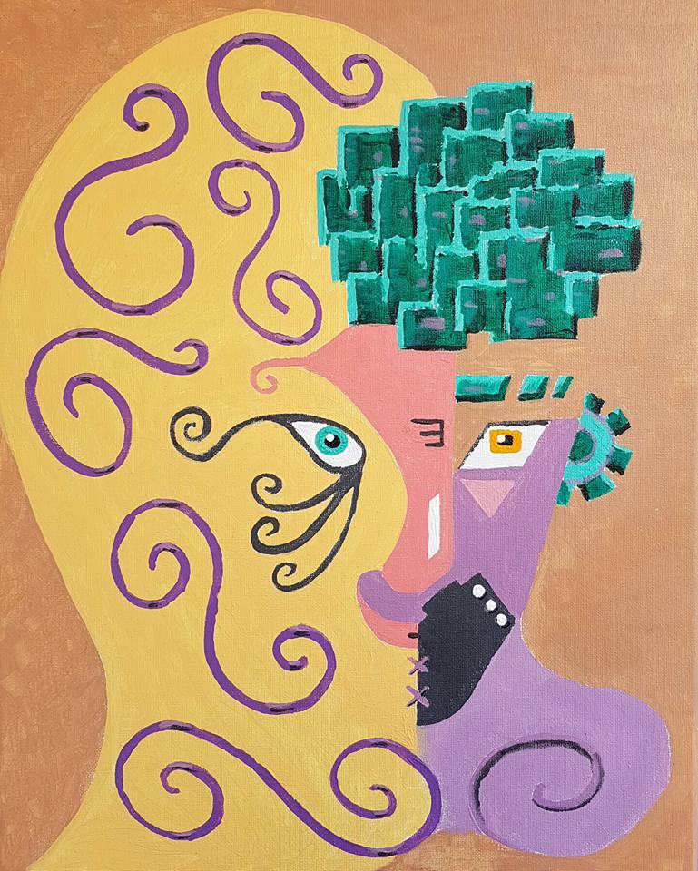
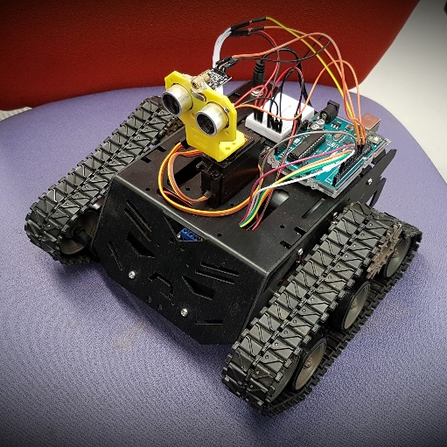
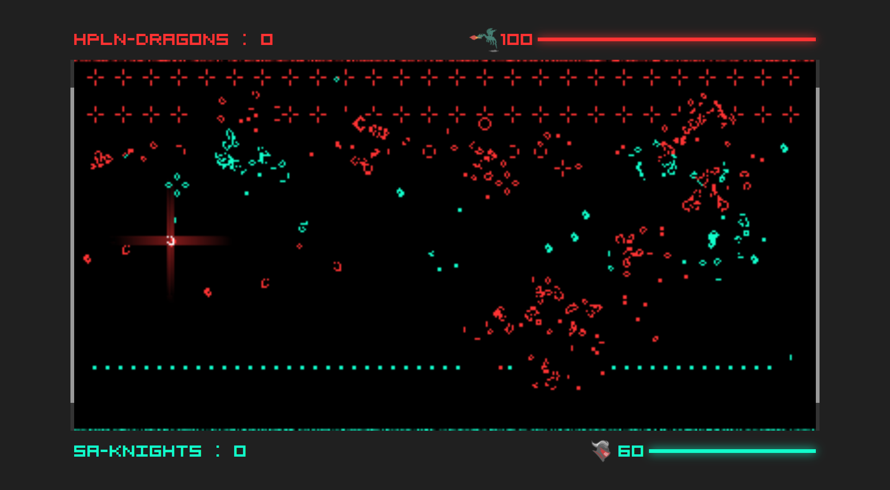
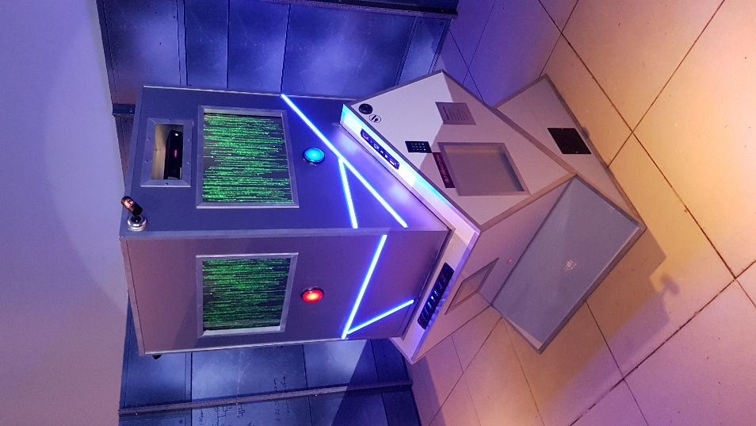



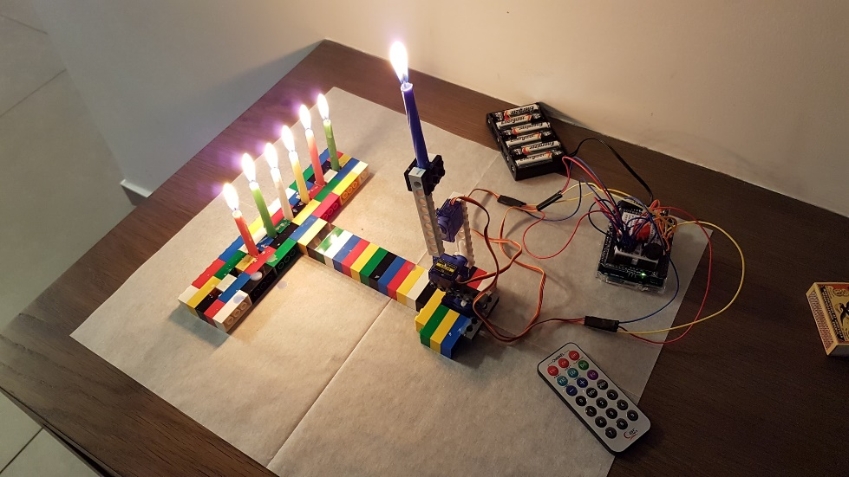
Notes:
Uri Kalish. Kalisz. 46. Married+3. Herzliya. Rehovot.
In Mercury/HP/HPE/MF since 2000. Developer and FA. LR, PT, PC, QC, ALM Octane.
Wanted to be: Musician, Physicist, Engineer, Programmer, Biologist.
Hobbies: Science, SciFi, Coding, Arduino, Music, Drawing.
- START RECORDING

Slide 2
Colors
Uri Kalish

Slide 3

This presentation is best viewed in a
dim lit room on a maximized screen
Notes:
Bring your kids.

Slide 4
Evolution
Psychology
Chemistry
Physics
Biology
Color Blindness
Computers
Effects
Q&A
AGENDA

Slide 5
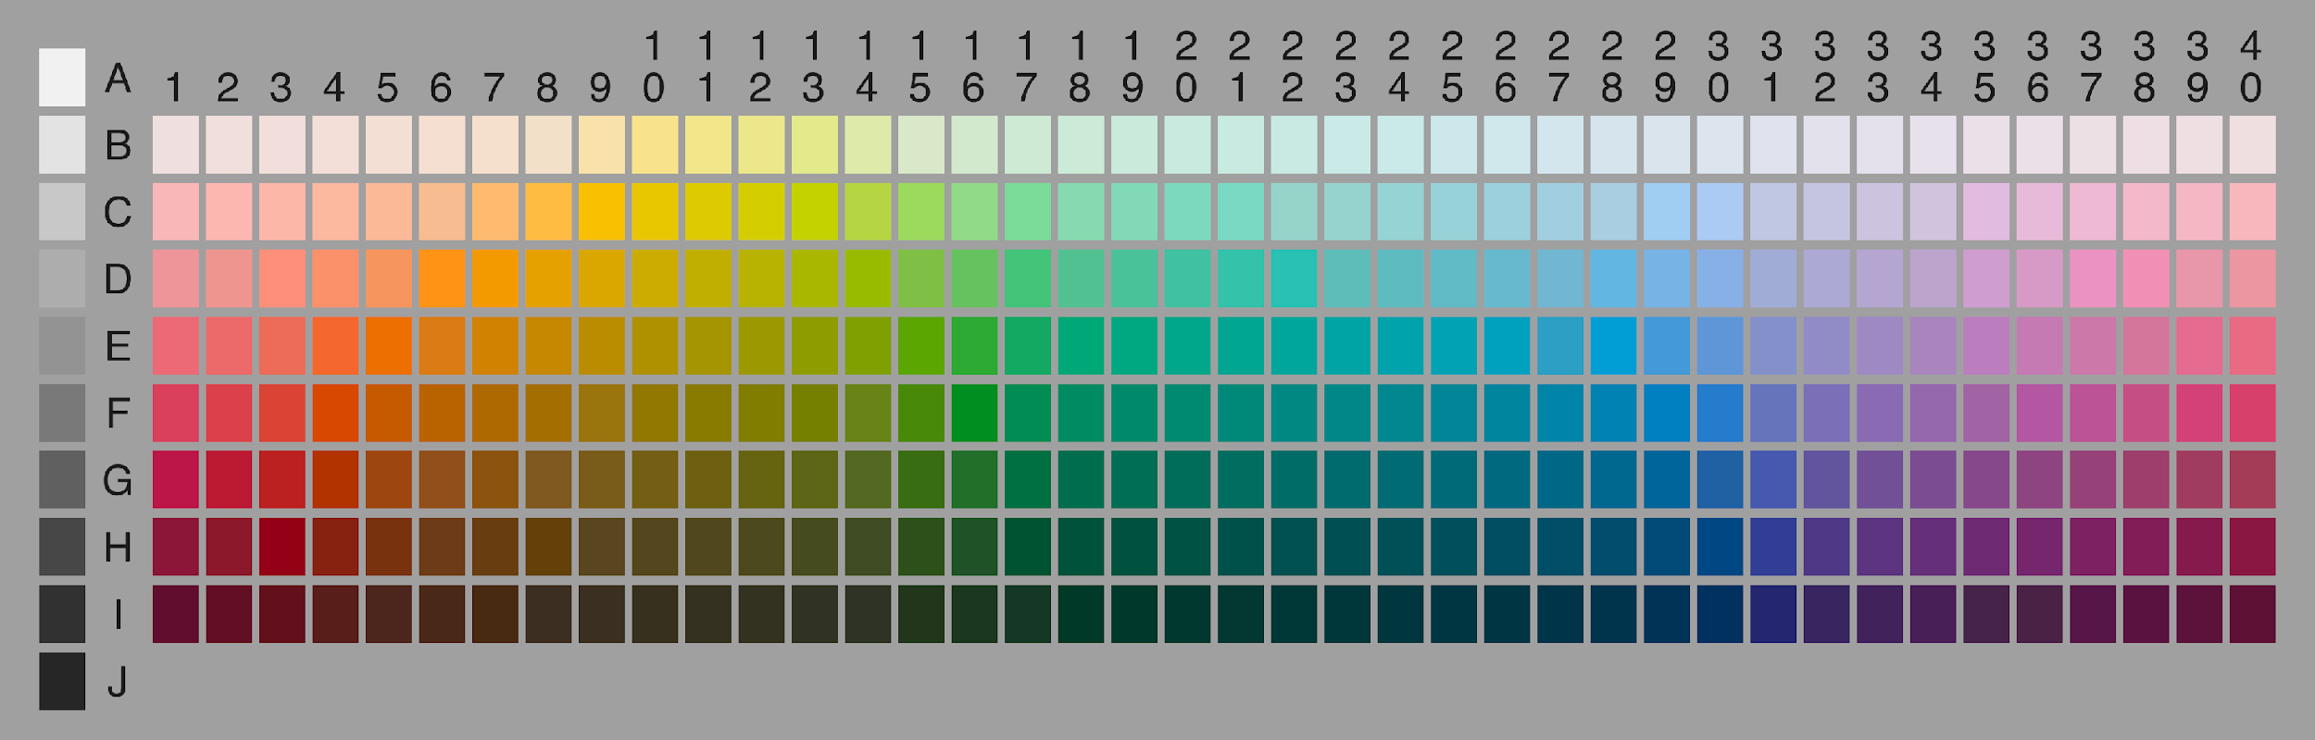
EVOLUTION
Notes:
Color is the characteristic of visual perception described through color categories (e.g. red, orange, yellow, green, etc.).

Slide 6
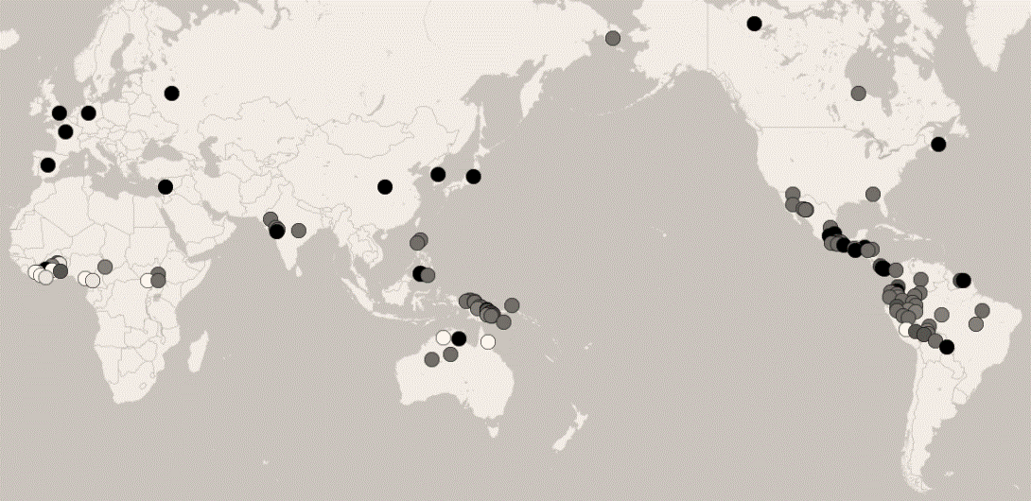
EVOLUTION
Notes:
Late 1970s - The World Color Survey
110 languages, all spoken by pre-industrial societies, many that have no written script.

Slide 7
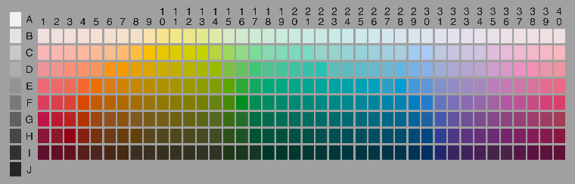
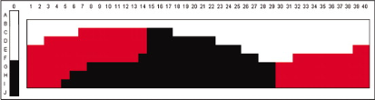
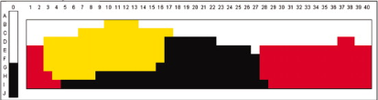
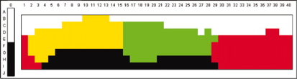
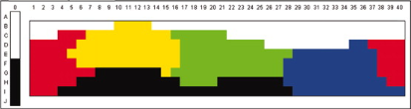
EVOLUTION
Notes:
Green-Blue in Japan.

Slide 8
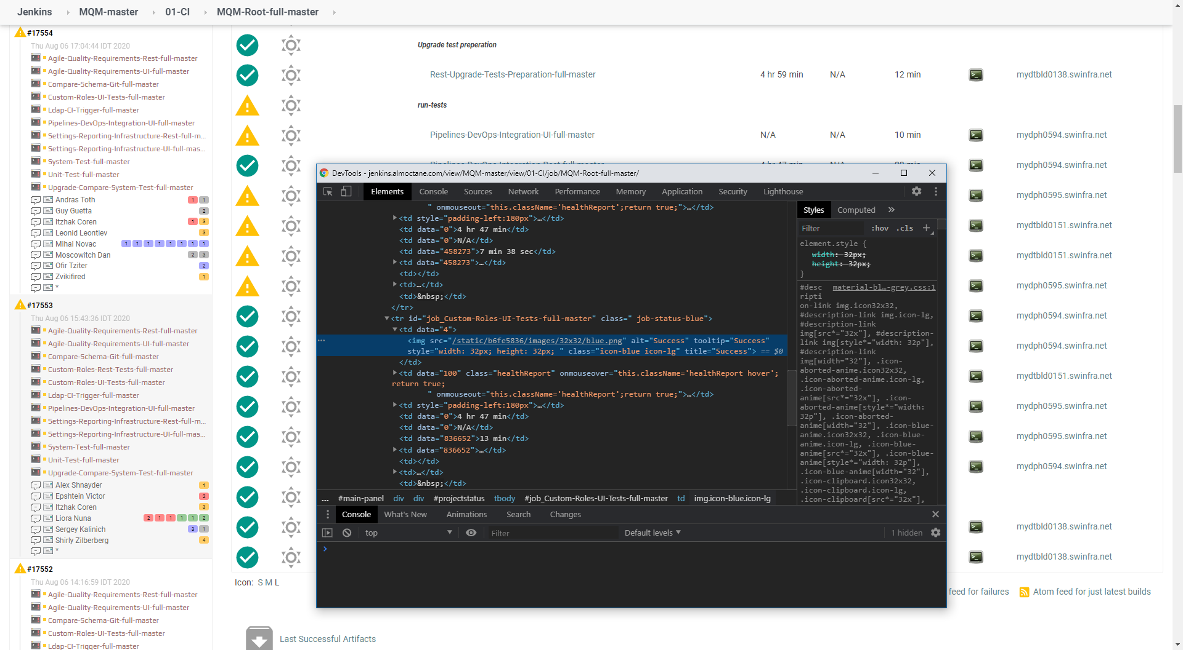
EVOLUTION
Notes:
Jenkins – Kohsuke Kawaguchi.
In Japan the “go” traffic light is blue.

Slide 9
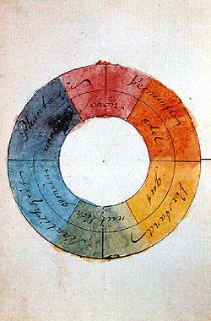
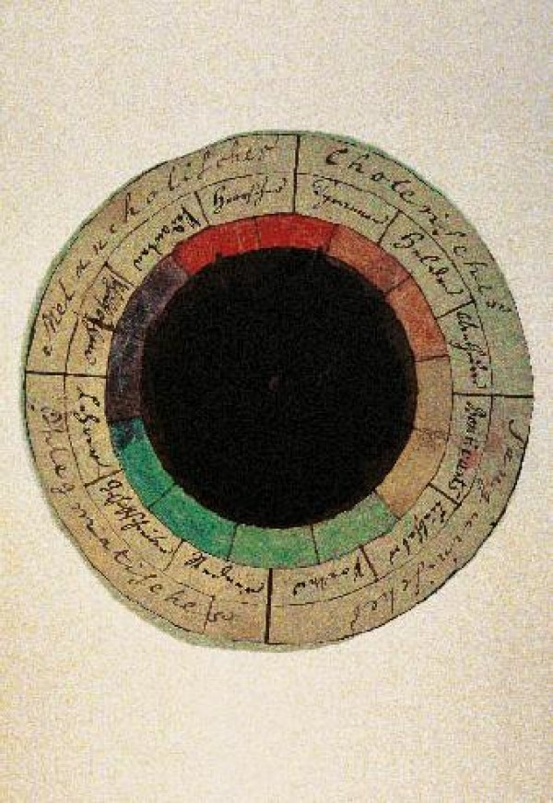
PSYCHOLOGY
Notes:
Goethe's Color Wheel (1809).
Red = "beautiful", orange = "noble", yellow = "good", green = "useful", blue = "common", violet = "unnecessary".
Rational = beautiful and noble, intellectual = good and useful, sensual = useful and common, imagination = beautiful and unnecessary.
The “Rose of Temperaments” (1798/9) by Goethe and Schiller. Matching 12 colors to human occupations or their character traits (tyrants, heroes, adventurers, hedonists, lovers, poets, public speakers, historians, teachers, philosophers, pedants, rulers).
Philosophers – unnecessary.
Teachers – common and unnecessary .

Slide 10
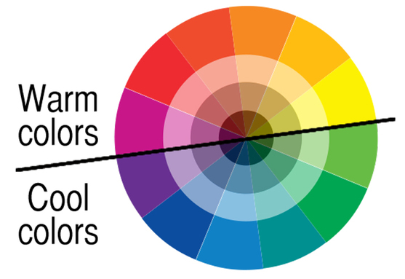
PSYCHOLOGY

Slide 11
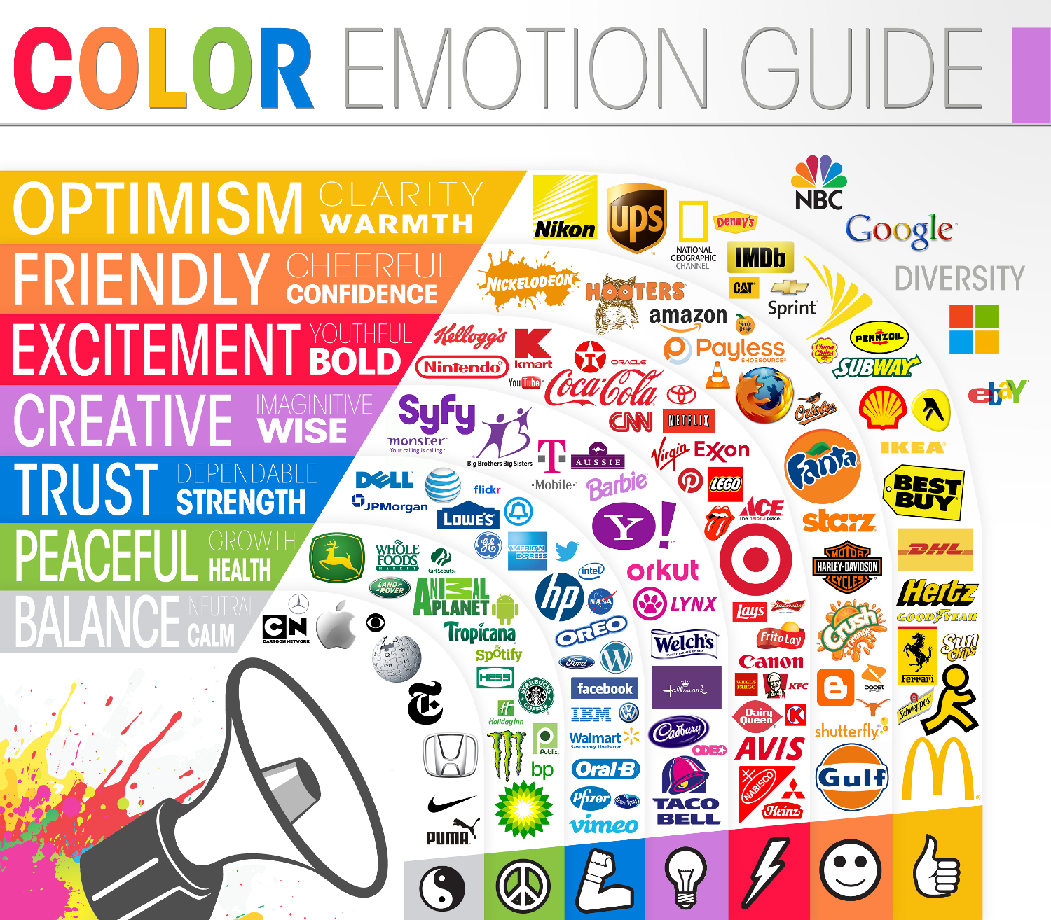
PSYCHOLOGY

Slide 12
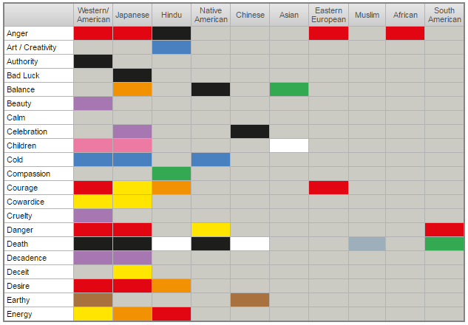
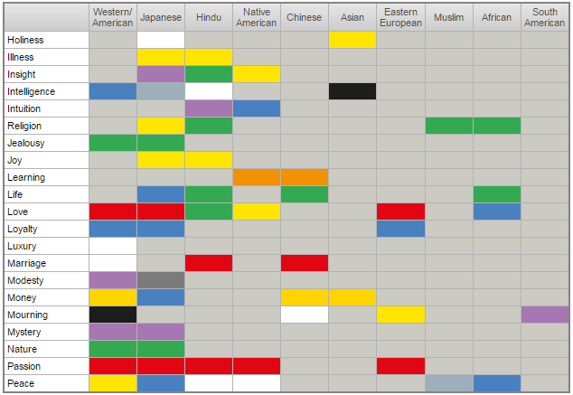
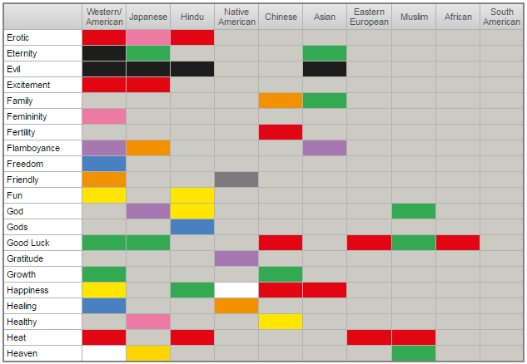
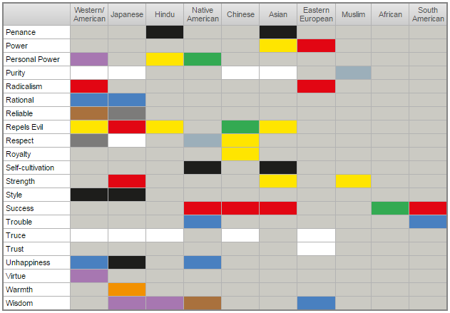
PSYCHOLOGY
Notes:
Happiness
Love
Courage

Slide 13
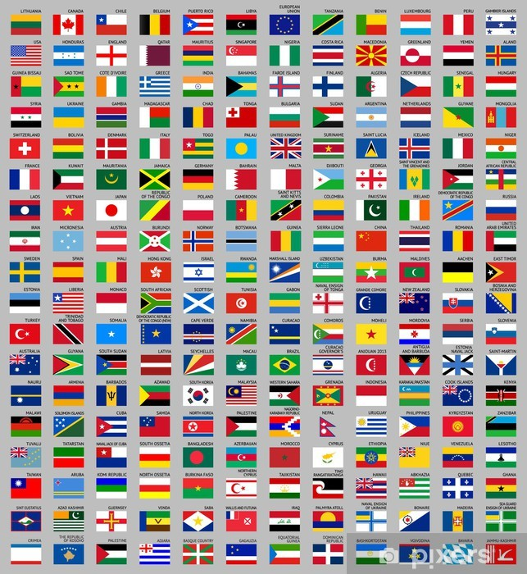
HISTORY
Notes:
Which basic color is missing?

Slide 14
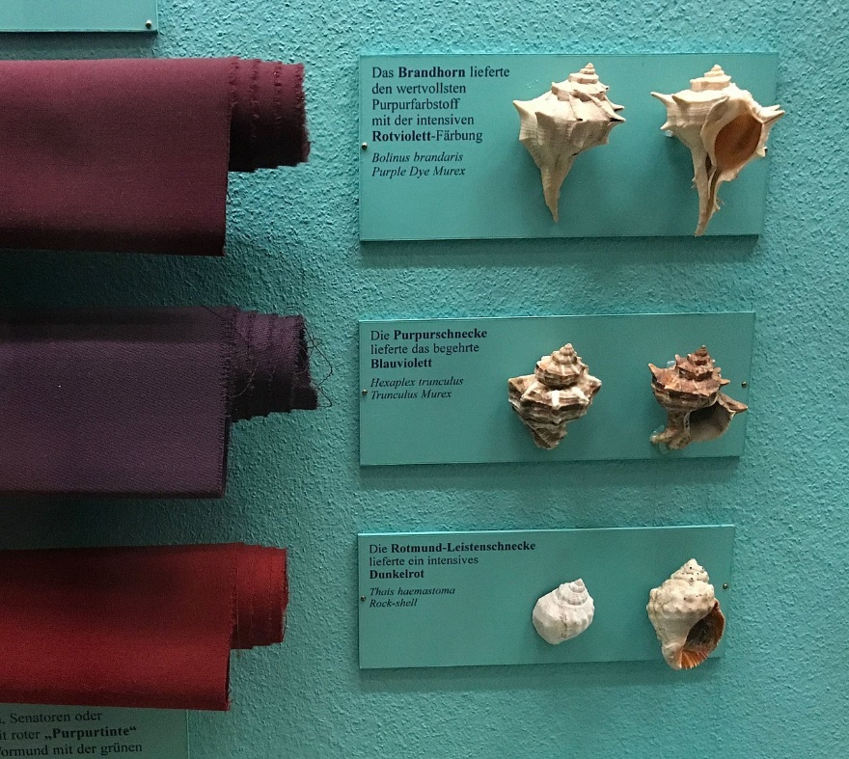
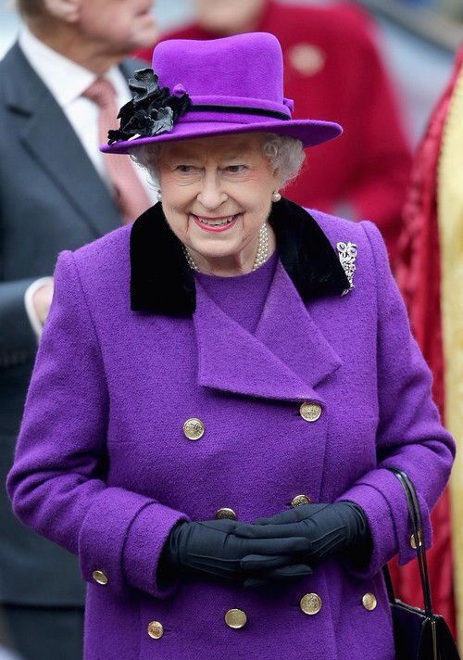
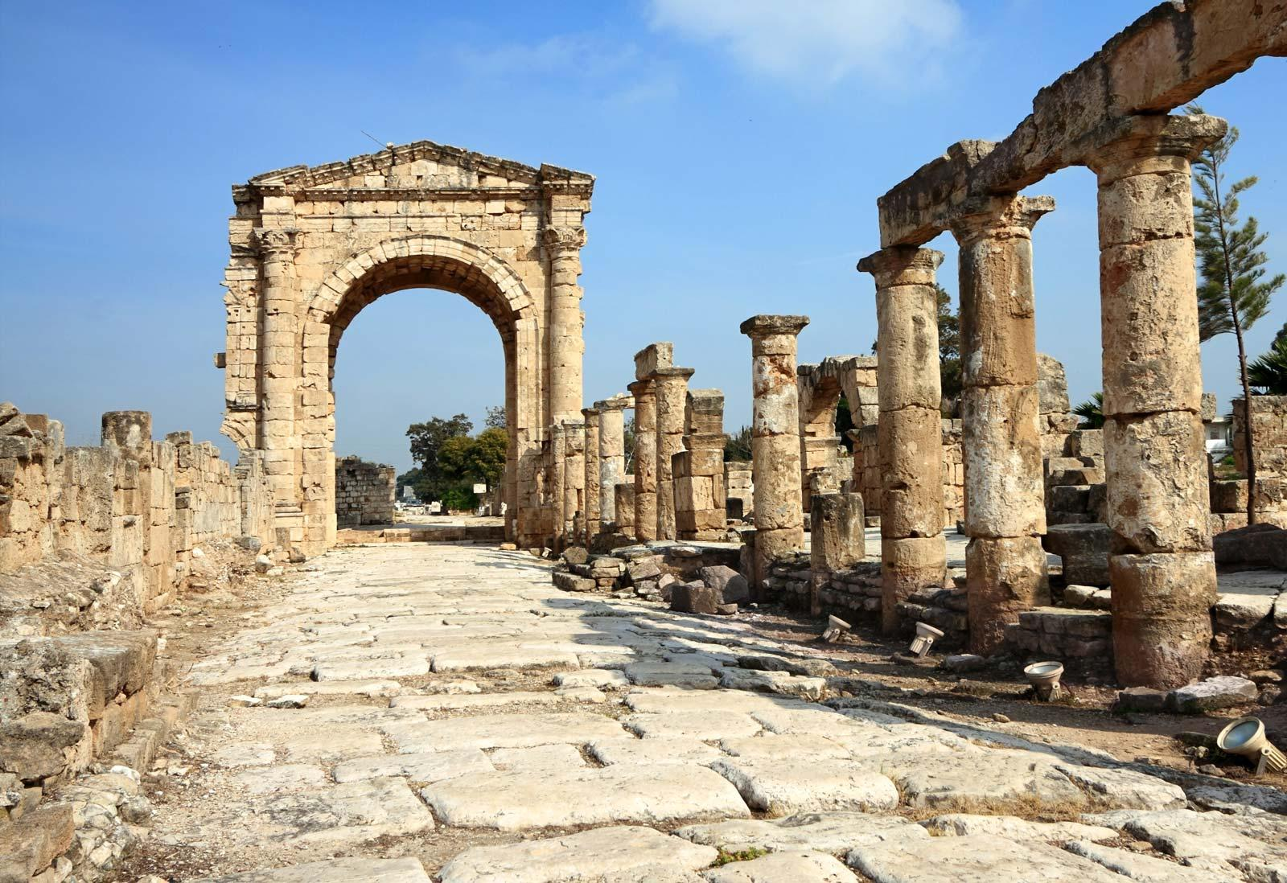
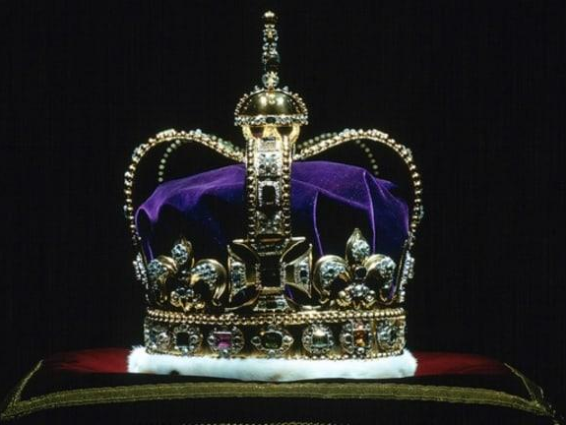
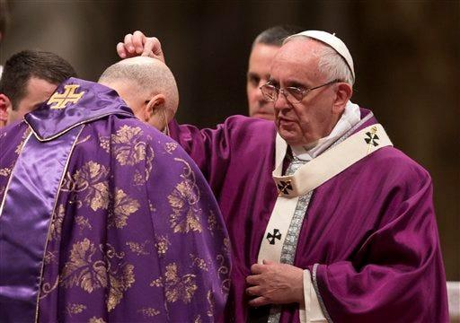
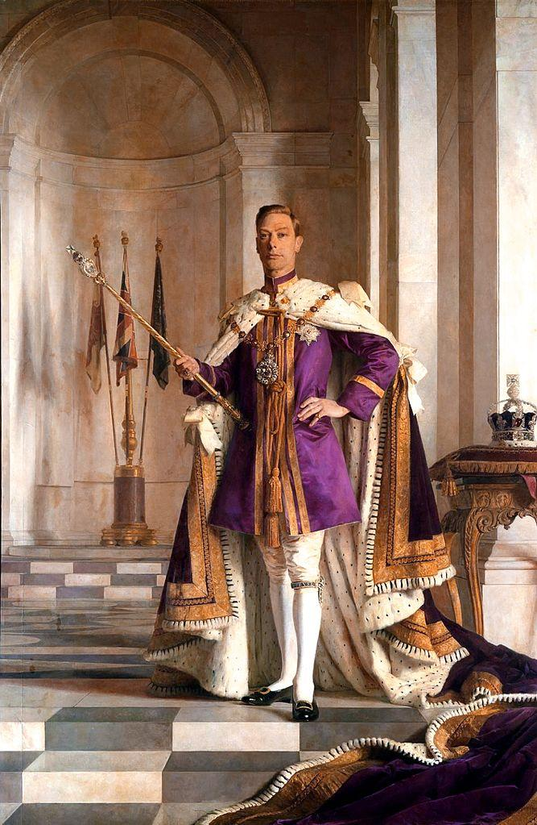
HISTORY
Notes:
Synthetic purple invented in mid 19th century.
Tyrian Purple / Phoenician Purple, Royal purple, Imperial purple.
1 drinking cup - about 2,000,000 sea snails – about $900,000.

Slide 15
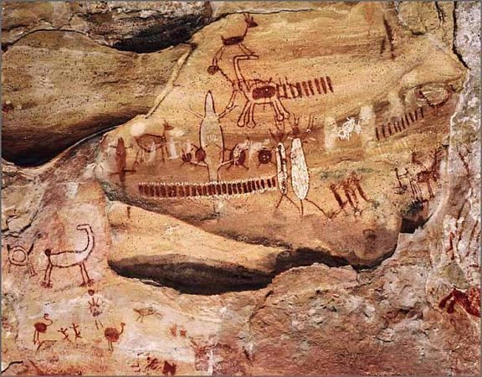
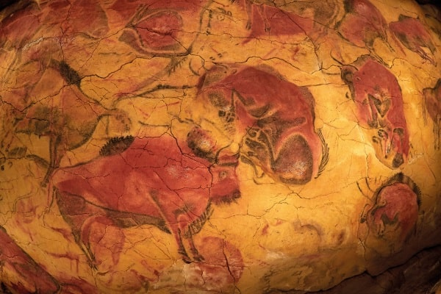
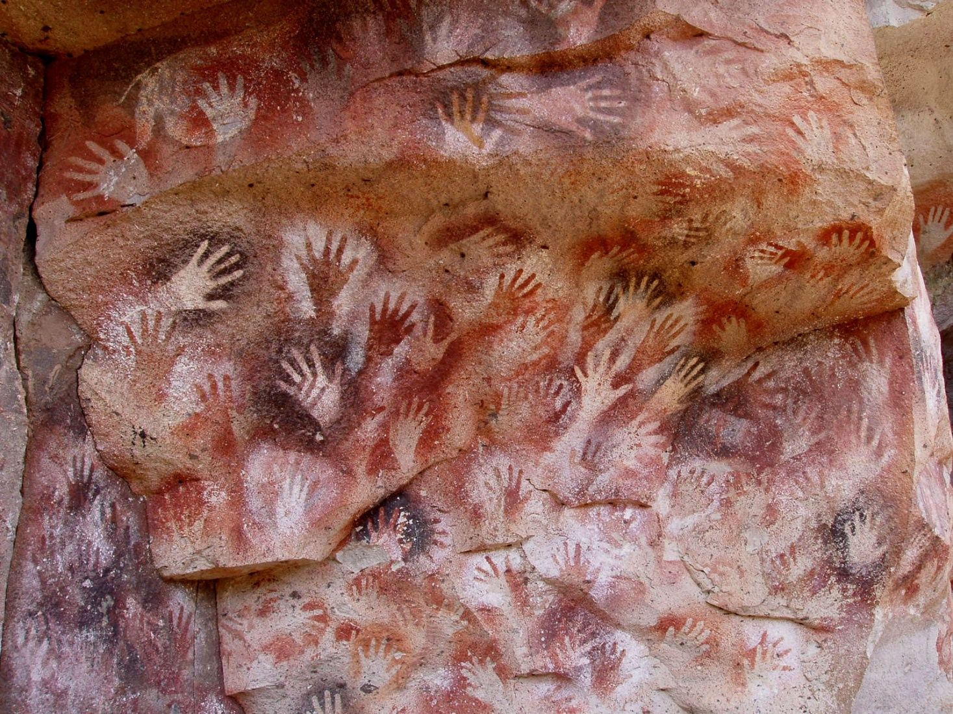
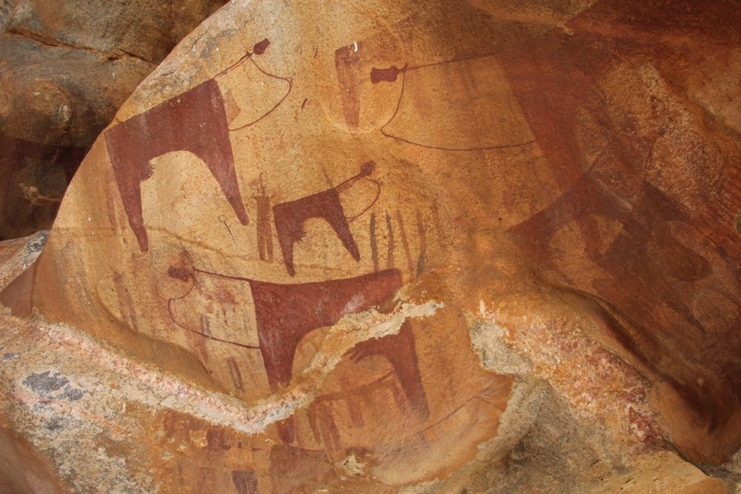
CHEMISTRY
Notes:
Dyes (organic) and pigments (inorganic) come from rocks, soil, plants, ash, blood, bones, etc.

Slide 16
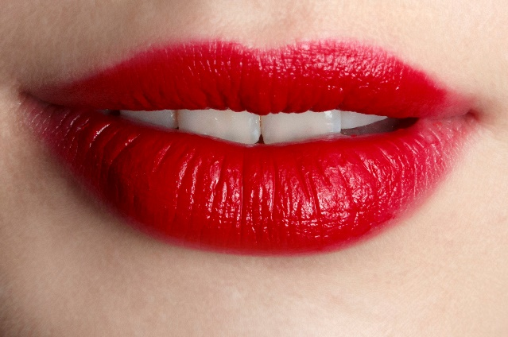
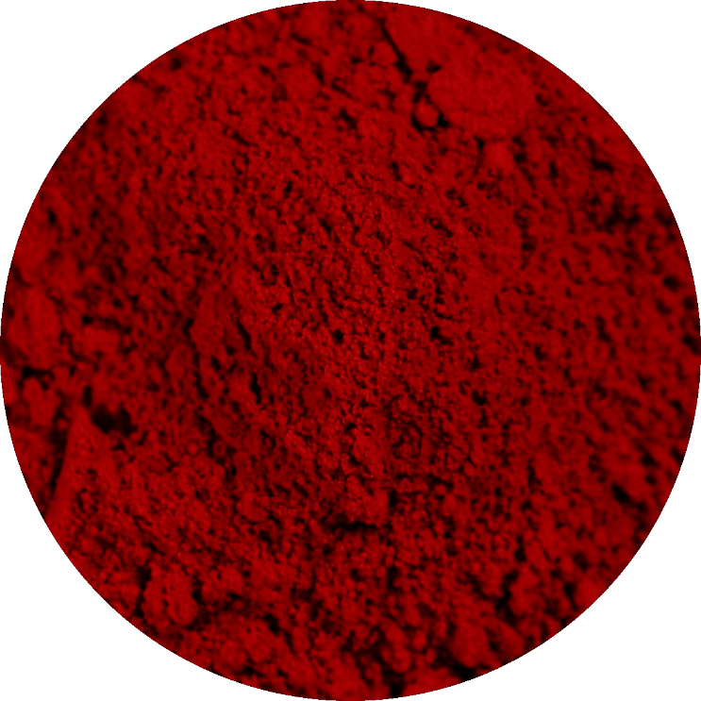
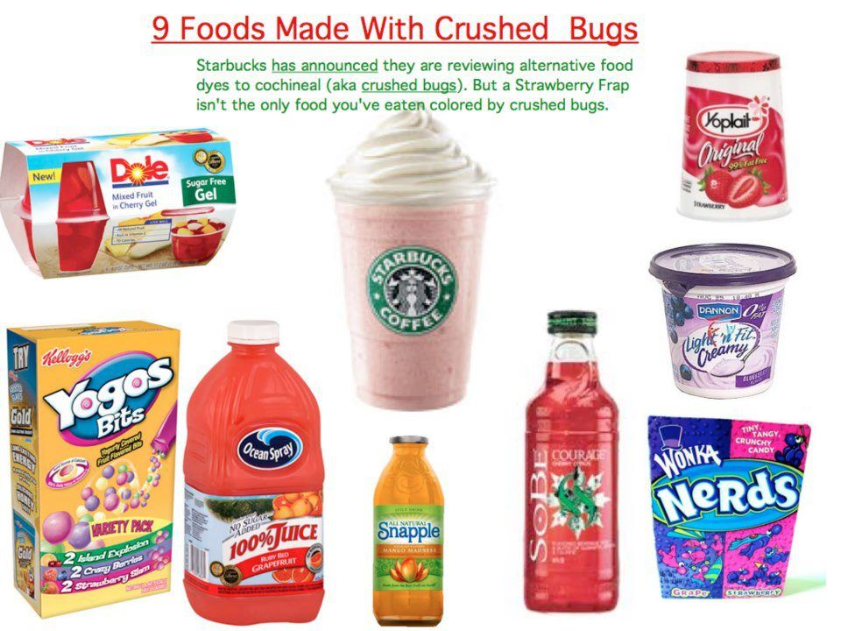
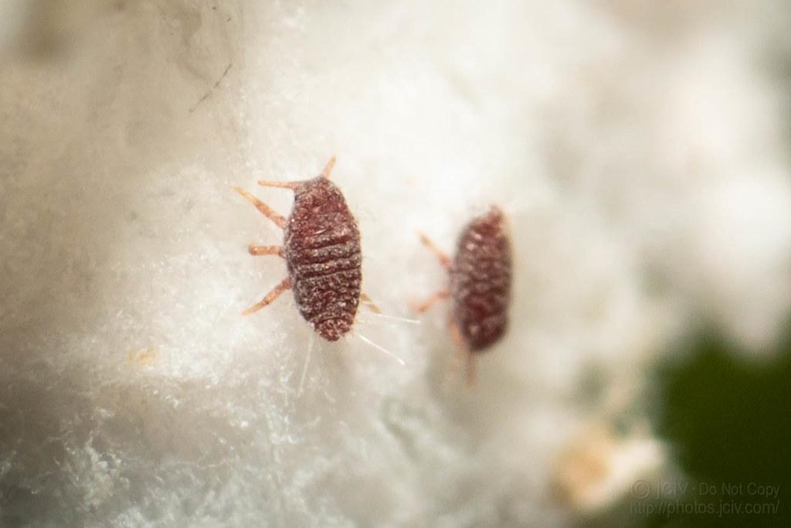
CHEMISTRY
Notes:
Carmine (E120) – Food, drinks, lipsticks.
Made from Cochineal, an insect living on Cactuses (in south and central America).
Kosher if the insects were crushed more than 1 year ago.

Slide 17
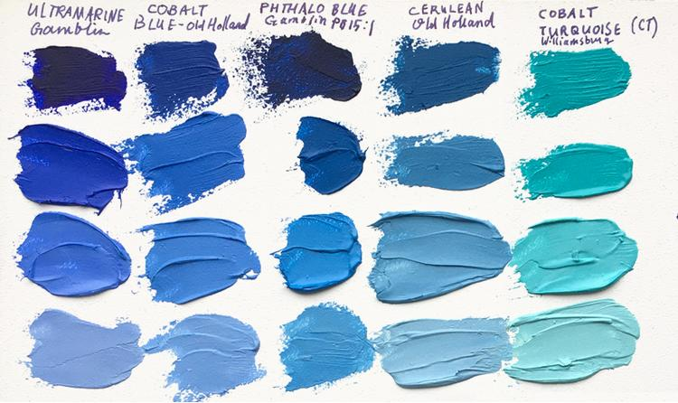
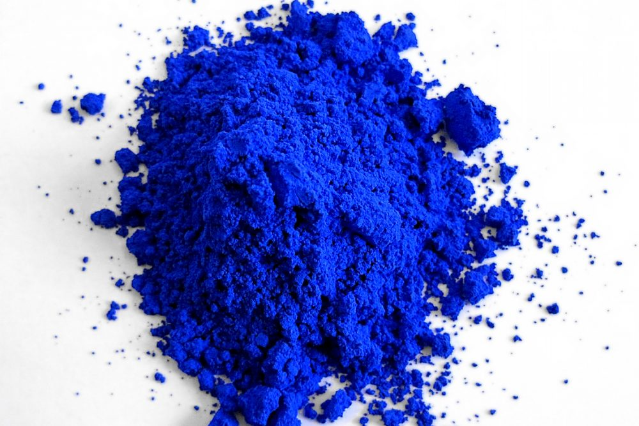
CHEMISTRY
Notes:
Blue is rare in nature. Many blue things are structural-based.
YinMn Blue (aka Oregon blue) - 2009 - 1st blue pigment after 200 years.

Slide 18
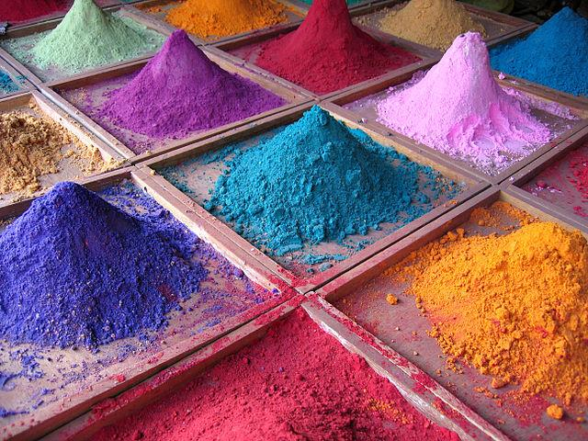
CHEMISTRY
Notes:
Pigments should be vibrant (mixing creates dull colors), stable (mix with other compounds, temperature, acidity), non-toxic (unlike Emerald green).

Slide 19
PHYSICS
Magenta
Purple
Violet
Indigo
Blue
Cyan
Green
Yellow
Orange
Red

Slide 20
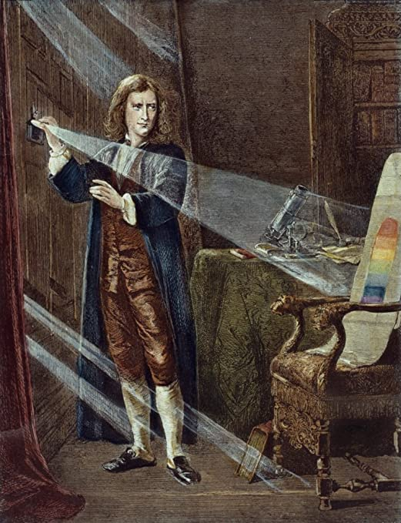
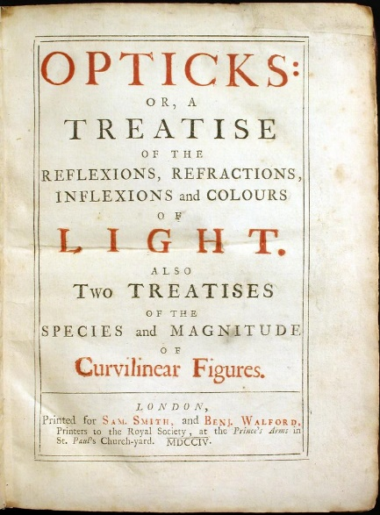
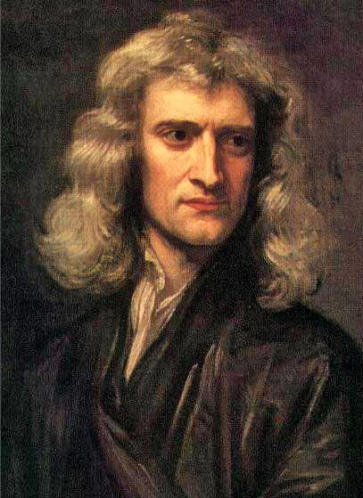
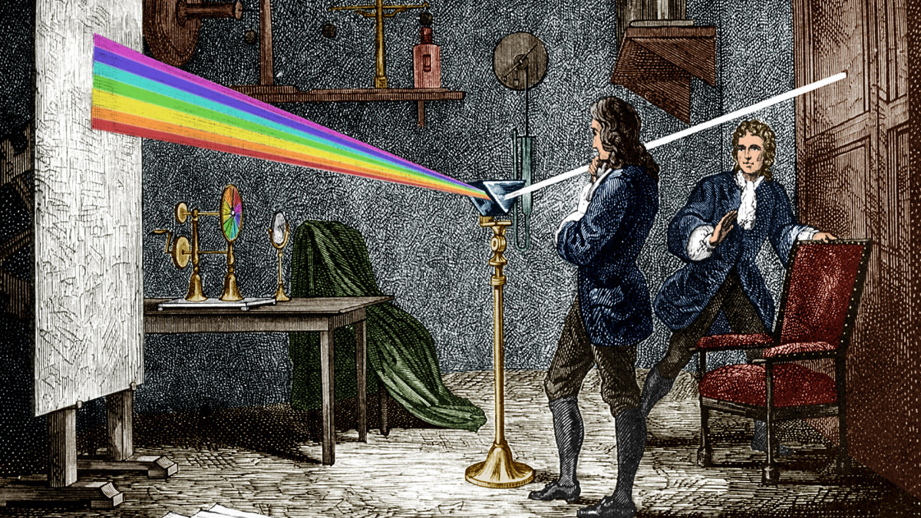
PHYSICS
Notes:
“Opticks” – Isaac Newton 1704.

Slide 21

PHYSICS
Notes:
The perception of color derives from the stimulation of photoreceptor cells in the eye by electromagnetic radiation.
Electromagnetic radiation is an electric and magnetic disturbance traveling at the speed of light using Photons. Unlike sound waves or waves in water, it can travel without a medium to carry it, so it can travel through space.
Gamma rays are produced by pulsars (rotating neutron stars), supernova explosions, and quasars (black holes accretion disks). On Earth, gamma rays are generated by radioactive decay, nuclear explosions, lightning.

Slide 22



PHYSICS
Notes:
Humans can see from 380nm-740nm
Some animals can see into IR.
Some animals (and people with missing or damaged cornia) can see into UV (looks to them as white-violet).

Slide 23
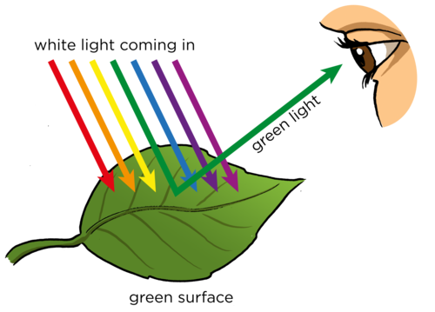
PHYSICS
Notes:
The color of an object is a result of the wavelengths and intensities of the light reflected from it after some frequencies were absorbed.

Slide 24
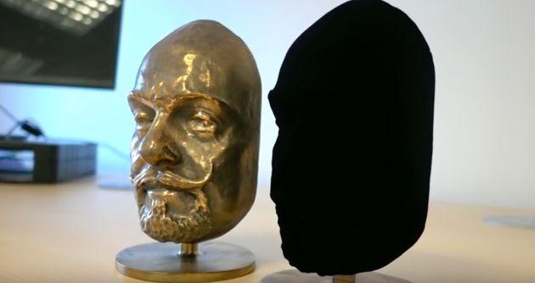
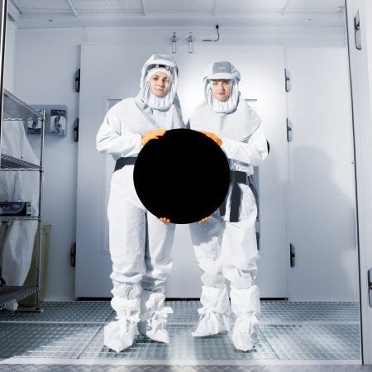
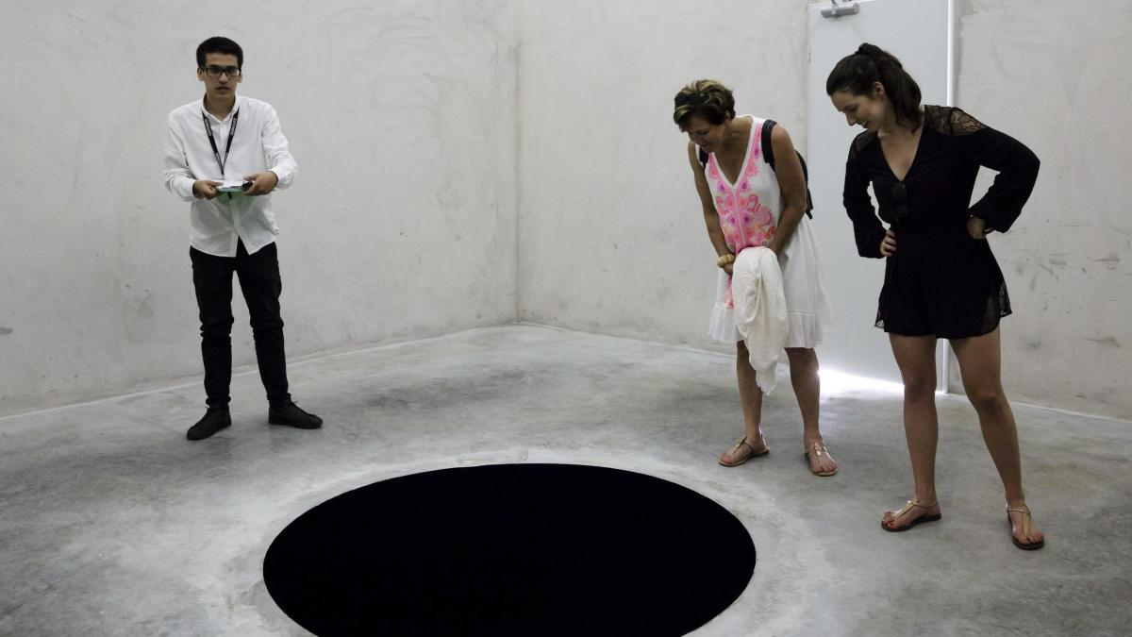
PHYSICS
Notes:
VantaBlack (“The Blackest Black”) – made out of carbon nanotubes – least reflective substance, absorbing 99.965% of incoming visible light.

Slide 25
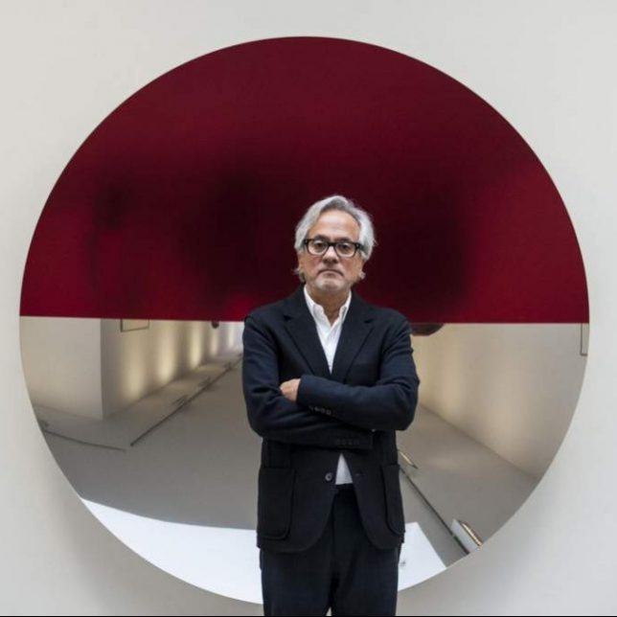


PHYSICS
Notes:
Anish Kapoor – exclusive licence to use VantaBlack sprayable paint for his art.
Stuart Semple – #sharethelack, “The Pinkest Pink”.

Slide 26

PHYSICS

Slide 27

BIOLOGY
Notes:
The Fovea comprises less than 1% of retinal size but takes up over 50% of the visual cortex in the brain. The fovea sees only the central two degrees of the visual field, (approximately twice the width of your thumbnail at arm's length).

Slide 28

BIOLOGY
Notes:
Light travels all the way back and the signals travels forwards.

Slide 29

BIOLOGY
Notes:
This image uses fake colors.
Cons - Color vision. Mainly in the Fovea. Fast response. Accurate.
Rods – Vision in dim light (can be stimulated by a single photon). Peripheral vision. Slow response. Not accurate (multiple rods builds up a response signal together).

Slide 30

BIOLOGY
Notes:
No rods in the Fovea.
Blind spot where the optic nerve is.

Slide 31
EFFECTS
R
L

Slide 32

BIOLOGY
Notes:
“Blue”, “Green”, “Red” are not “scientific” – better use “S”, “M”, “L”.

Slide 33

BIOLOGY
Notes:
Humans tend to perceive light within the green parts of the spectrum as brighter than red or blue light of equal power, so the brightness function is almost identical to the spectral sensitivity of M cones.

Slide 34

BIOLOGY
Notes:
Different vision for different people – number of cones (1-4), genetic mutations in structure of photoreceptors cause different wavelength-responses, distribution of cones, age - old vision is more dim (loss of rods) and more yellowish.

Slide 35


BIOLOGY

Slide 36
FAKE!
BIOLOGY
Notes:
Magenta / Fuchsia

Slide 37

BIOLOGY
Notes:
Monochromatic colors are on the rim.
Magenta is an invented color between blue-purple and red.

Slide 38

BIOLOGY

Slide 39

BIOLOGY
74 - Normal Vision
21 - Strong Color Blindness

Slide 40

BIOLOGY

Slide 41



Slide 42

TECHNOLOGY
Notes:
Why Black in cartridges? Non-exact primitives (dirty brown). More economic.

Slide 43


TECHNOLOGY

Slide 44

TECHNOLOGY
Notes:
Color Gamut - the subset of colors which can be accurately represented in a given color space or by a certain device.

Slide 46


EFFECTS
Notes:
“The Dress” - blue and black or white and gold?

Slide 47

EFFECTS
Notes:
Your neighbors can affect your perceived brightness.
“Things in shadows makes them appear darker – so they must be lighter than they appear to be”.
“Chess board has light squares next to dark ones”.

Slide 48


EFFECTS
Notes:
After-image effect

Slide 49

EFFECTS

Slide 50

EFFECTS
Notes:
The McCollough effect

Slide 51



THIS IS NOT A JOKE! THIS EFFECT HAD BEEN DEMONSTRATED TO MESS UP VISUAL PERCEPTION FOR SEVERAL MONTHS! DO NOT LOOK AT THE GIF FOR MORE THAN 30 SECONDS!

Slide 52
Ready?

Slide 53


Slide 54


Slide 55
EFFECTS

Slide 56

EFFECTS
Notes:
Eclipse of Mars

Slide 57




EFFECTS

Slide 58
Q&A

Slide 59
“I didn’t understand the entire subject! Bad lecture! Avoid at all costs!”
Stevie Wonder
“It was very difficult to hear the lecture, but the slides were actually quite beautiful.”
Vincent van Gogh
“I have a truly marvelous review about this lecture, which this margin is too narrow to contain...”
Pierre de Fermat

Slide 60
Thank You

